Slide 1
COSC 2430 End of Semester Survey Results
The Total Number of Students Responded: 63
The Total Number of Students Responded and entered their PeopleSoft ID: 61

Slide 2
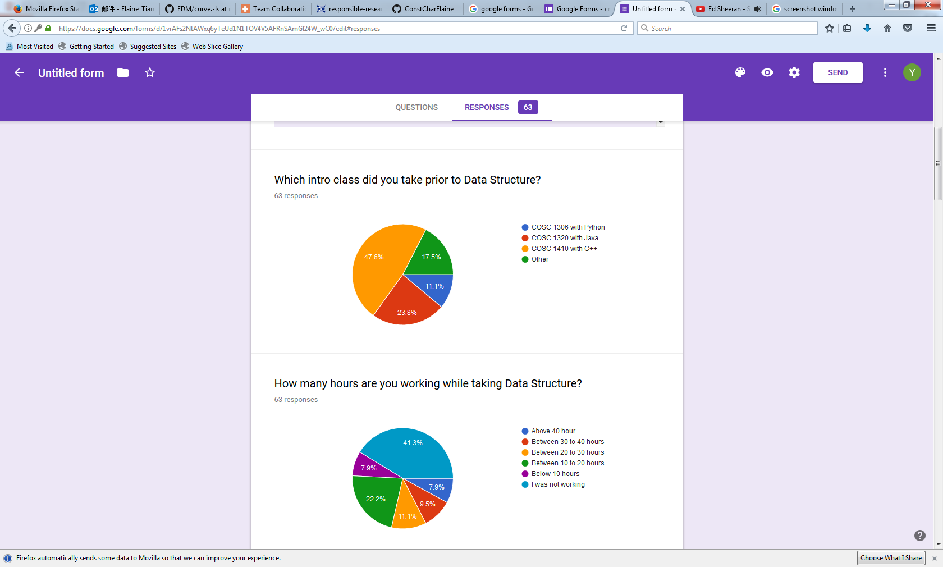
Question 1
Students who went with the “Other” option did not specify which class they took before Data Structure. But a possible guess is that they transferred to UH with intro classes already taken at community colleges or other universities.

Slide 3
Question 2

Slide 4
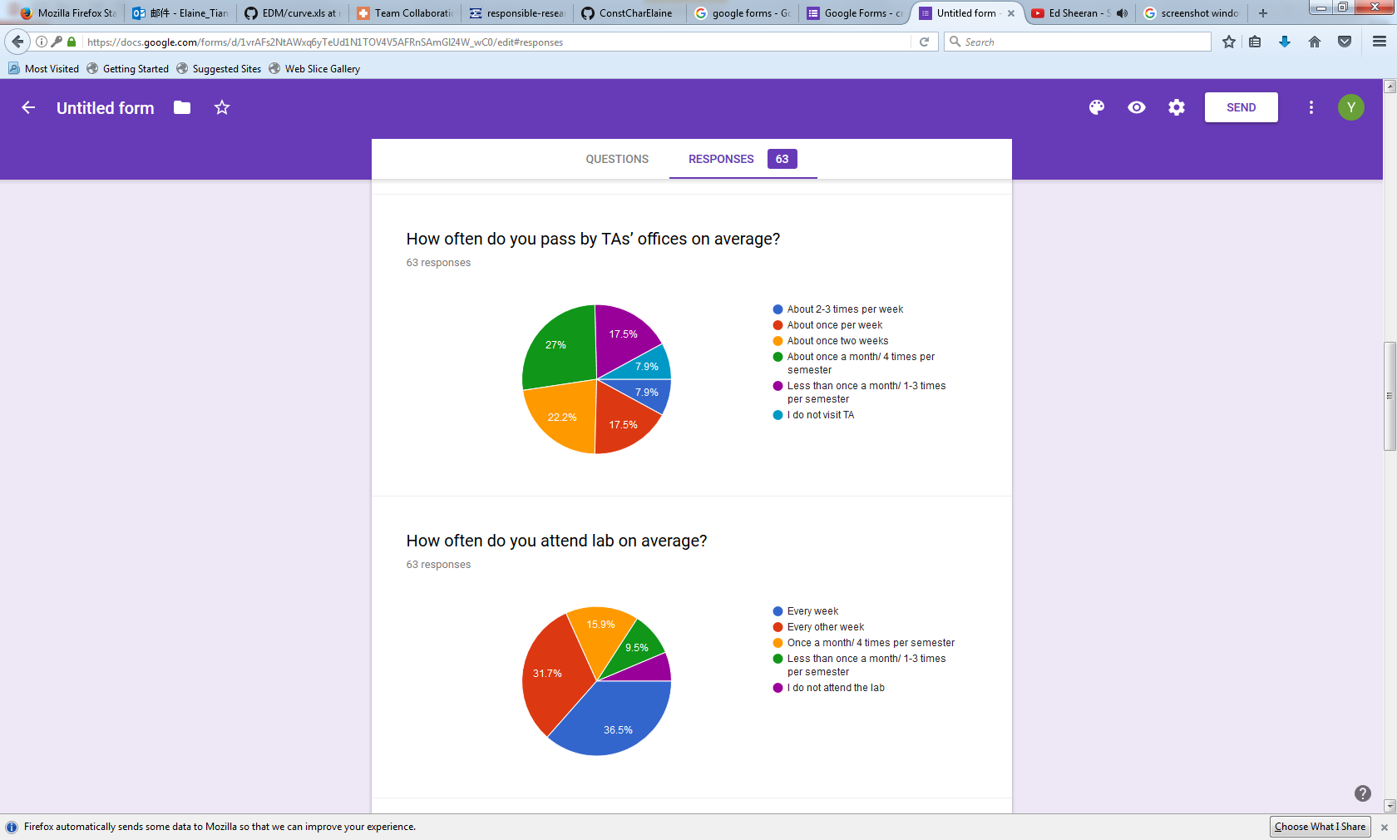
Question 4

Slide 5
Question 5
Purple (5): 6.3%

Slide 6
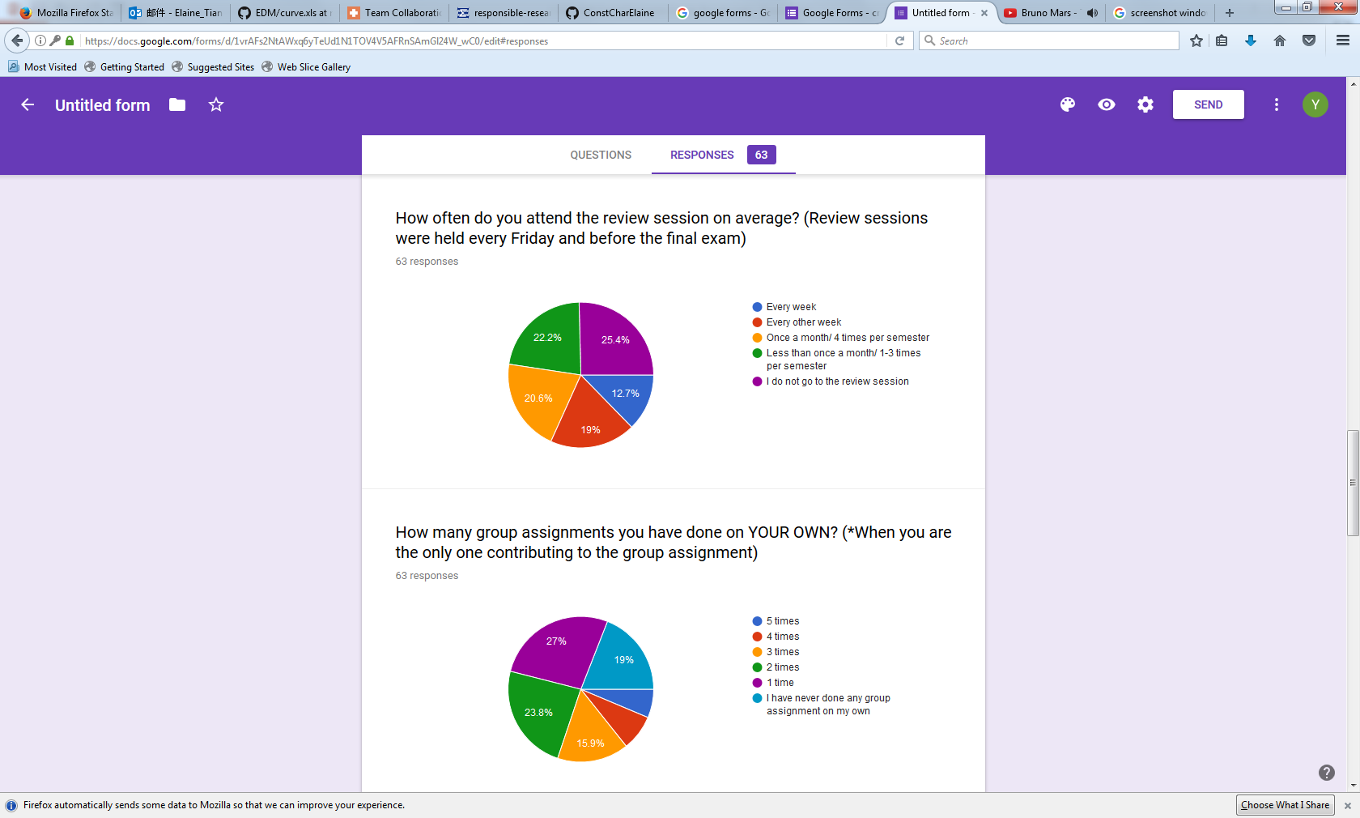
Question 6

Slide 7
Question 7
Deep Blue (1): 6.3%
Orange (2): 7.9%

Slide 8
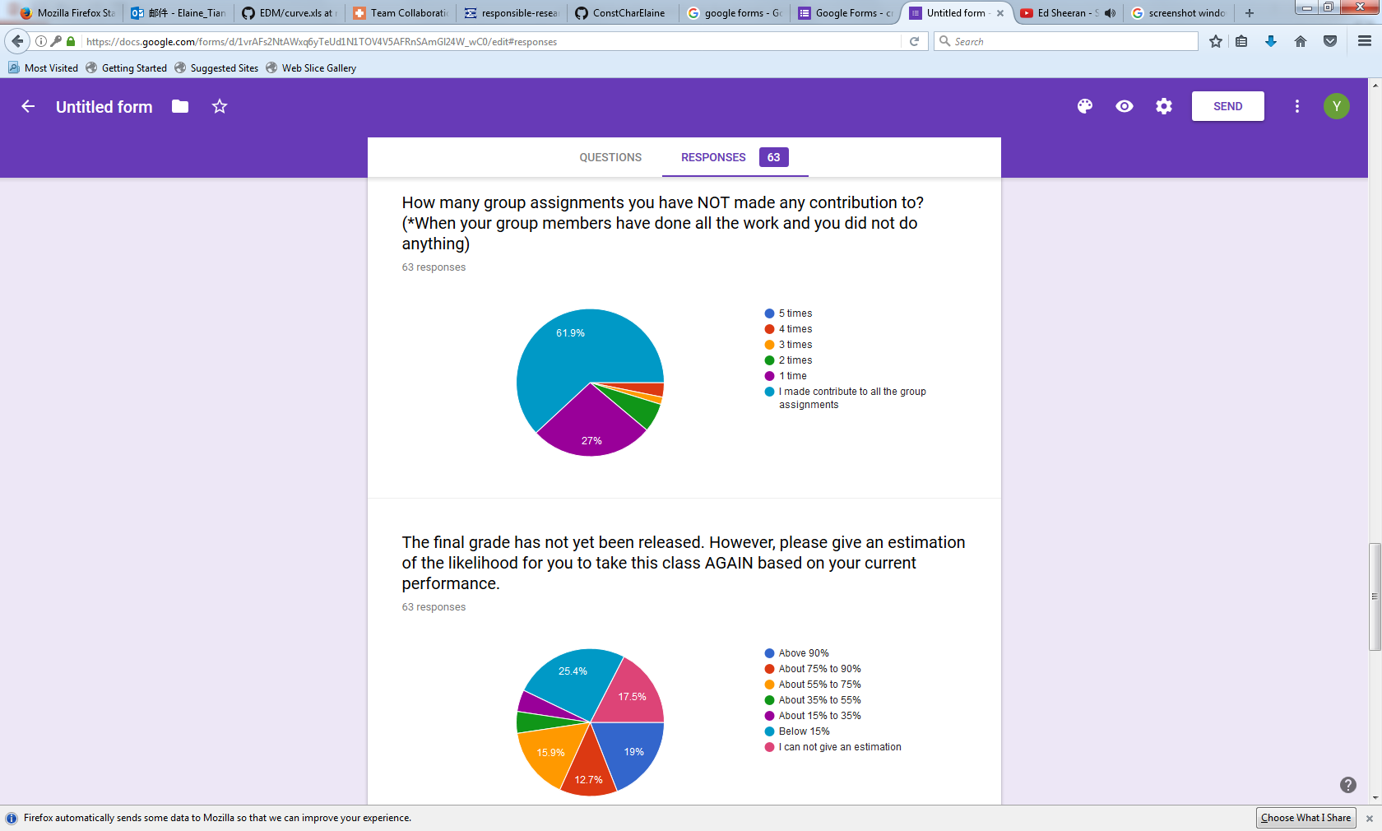
Question 8
Orange (2): 3.2%
Yellow (3): 1.6%
Green (4): 6.3%

Slide 9
Question 9
Green (4): 4.8%
Purple (5): 4.8%
(Yellow 15.9% + Orange 12.7% + Deep Blue19%)= 47.6% of the students who responded to the survey says there is more than 55% of the chance for them to take this class again (due to poor performance).
Thus, I wish you help me to check if this question is worded clearly or can lead to other interpretations. Thank you!

Slide 10
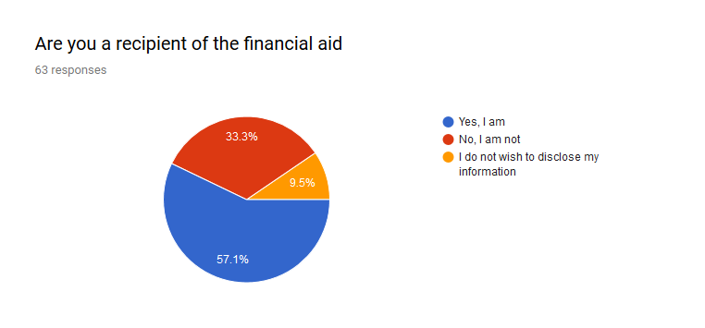
Question 10

Slide 11
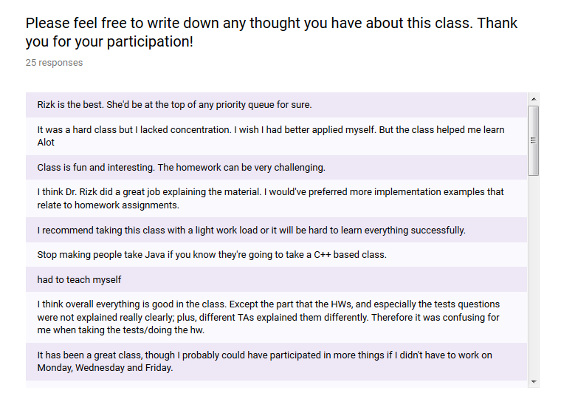
Open-ended Question

Slide 12
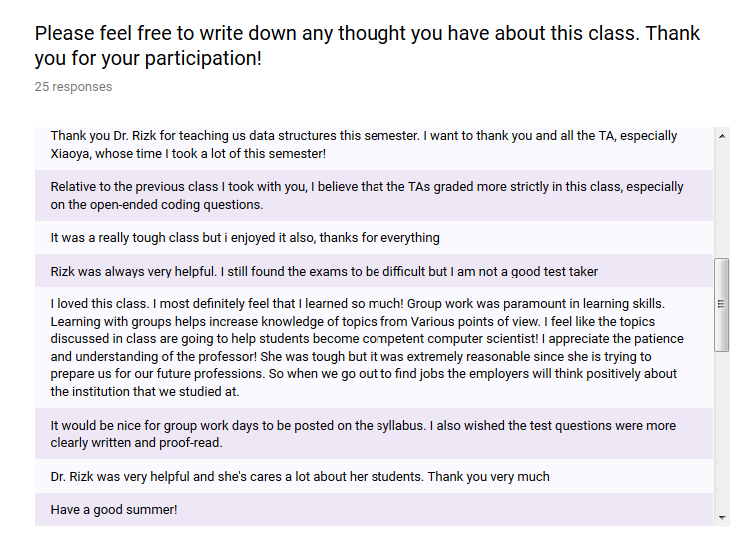

Slide 13
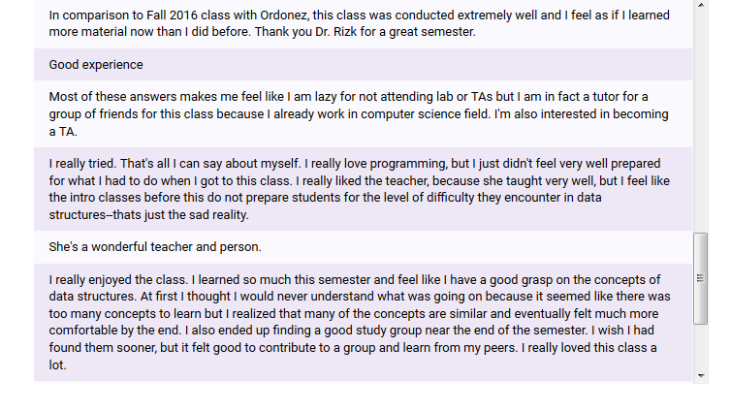
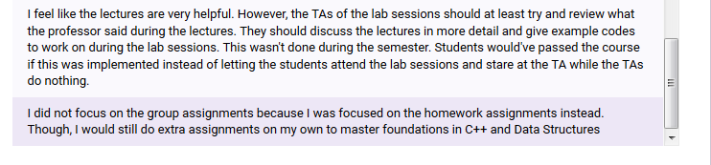

Slide 14
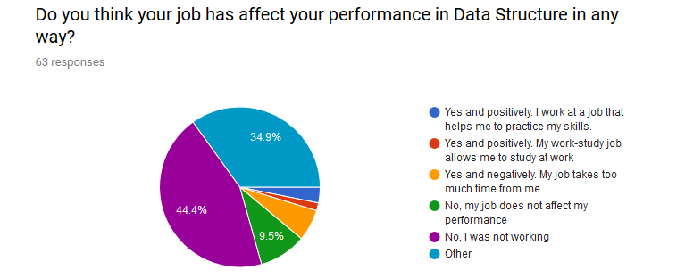
*Question 3
Deep Blue (1): 3.2%
Orange (2): 1.6%
Yellow (3): 6.3%
My apology for a mistake occurred at Question 3
The yellow option was worded wrong as a copy and paste error, originally is says “yes and negatively. My work-study job allows me to study at work.” and was later changed to the current option displayed “yes and negatively. My job takes too much time from me.”
Thus, I suggest to disregard the yellow portion in the graph, and only look at Deep Blue(1), Orange(2), Green (4) and Purple (5) parts of the graph. Thank you!

Slide 15
The End
Please feel free to share your thoughts and thank you!

